Slide 1
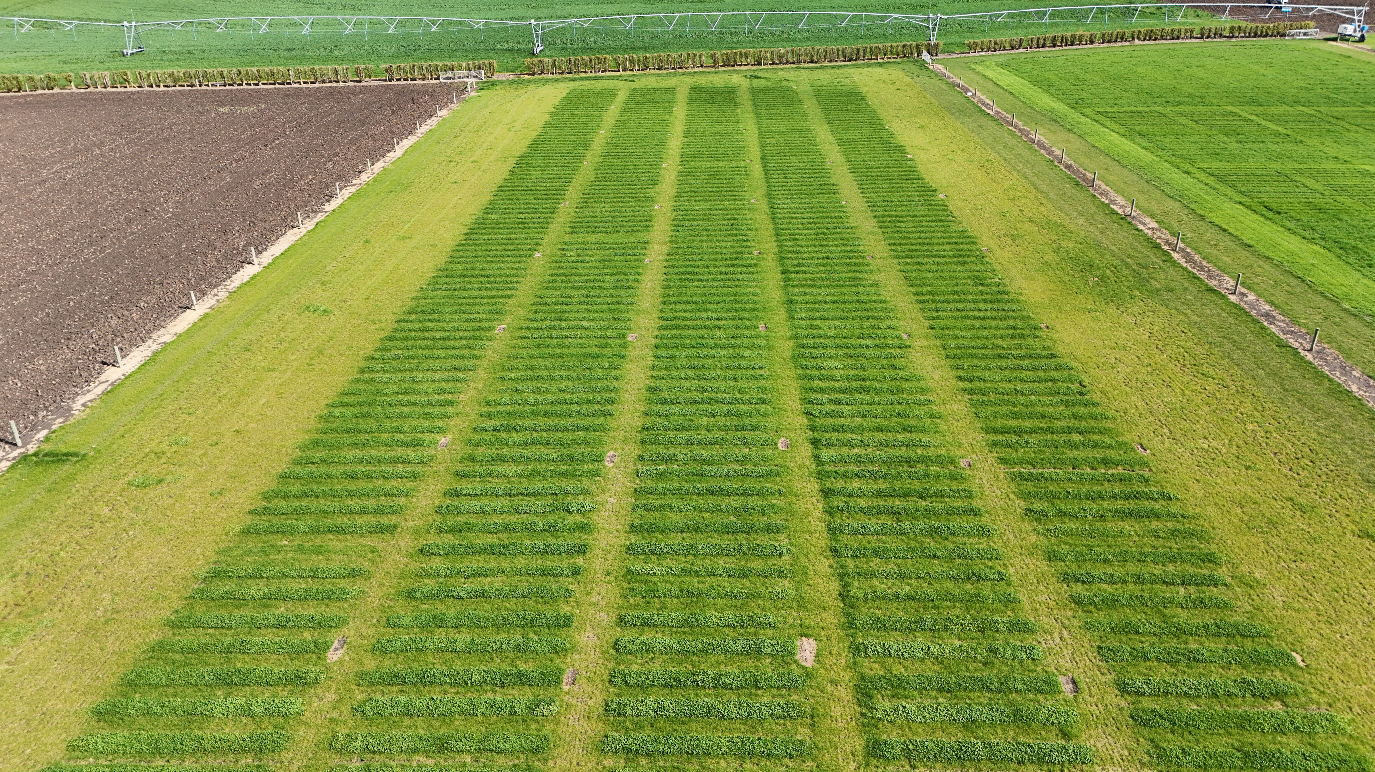
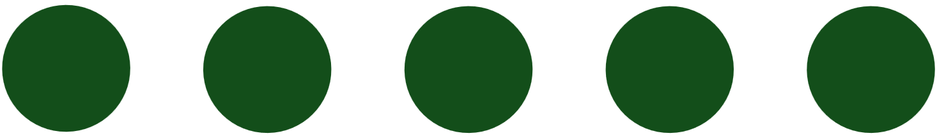
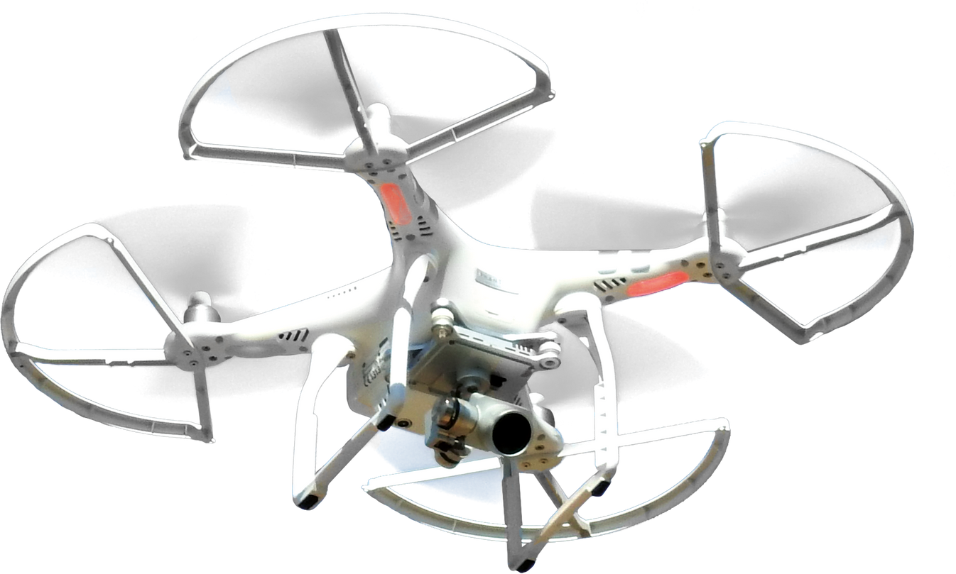

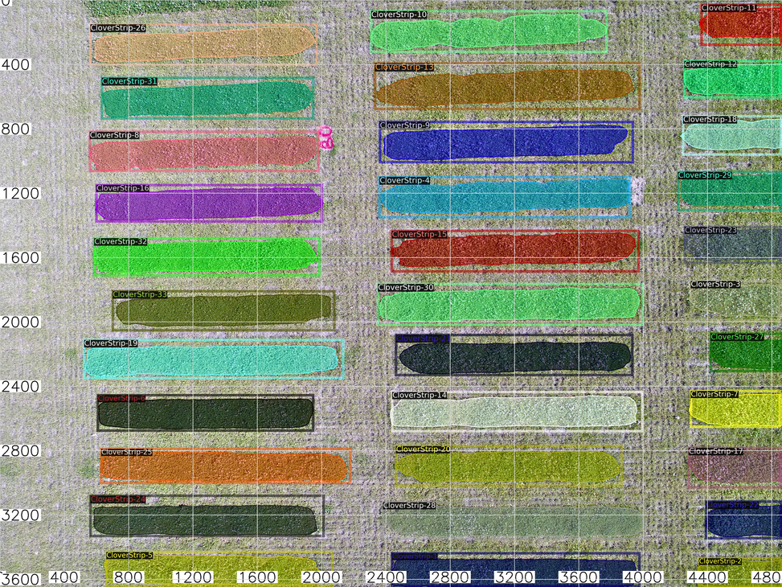


CLOVER DETECTION
IN AGRICULTURE
With Drones and Machine Learning
Wei Gao

Slide 2
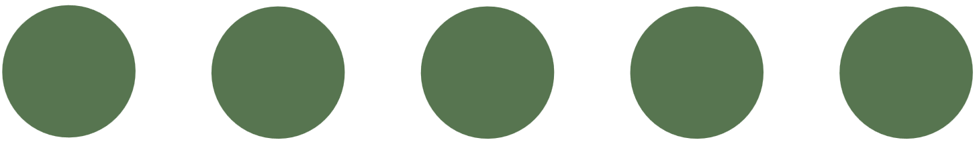


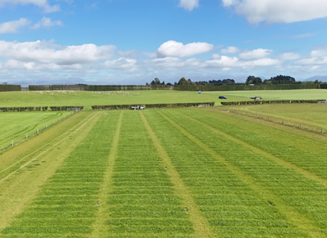
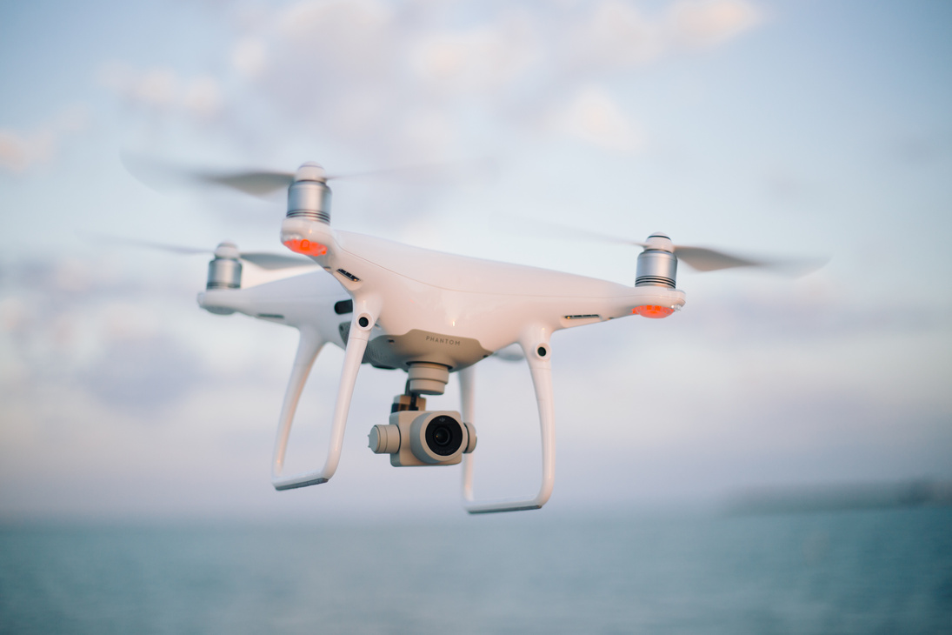


Background
Automated Clover Plot Detection
Use drone images and machine learning for precise identification
Objective & Pixel-Level Analysis
Provide quantifiable coverage data, reducing observer bias.
Efficiency & Scalability
Manual Observation
Minimize manual labor and speeds up large-scale field analysis.
Time-Consuming
Labor-Intensive
Subjective & Inconsistent

Slide 3
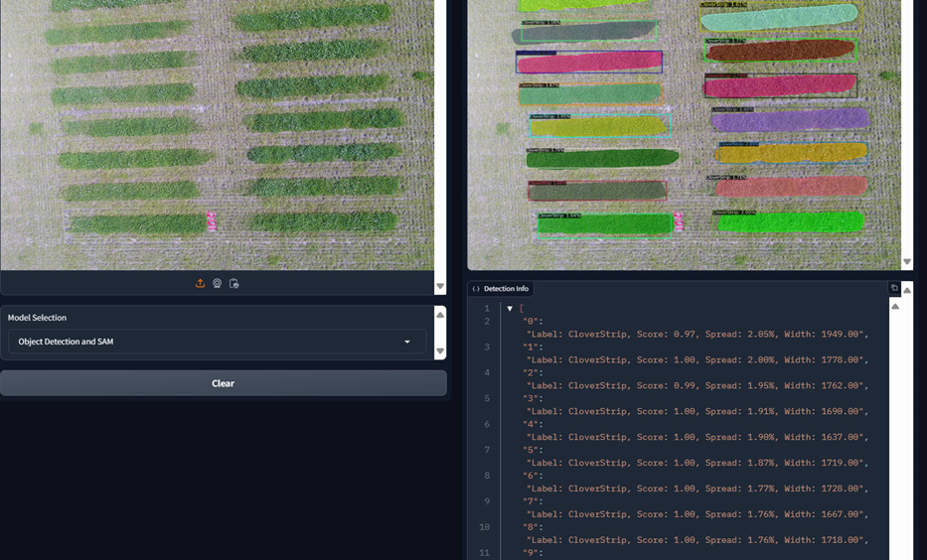
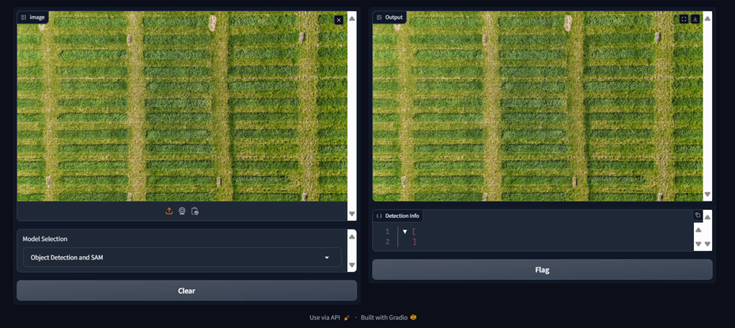

Background
Low prediction accuracy
Mismatched Data and Image
Very Basic interface
Inconvenient to use
Difficult to Assess Clover Growth

Slide 4
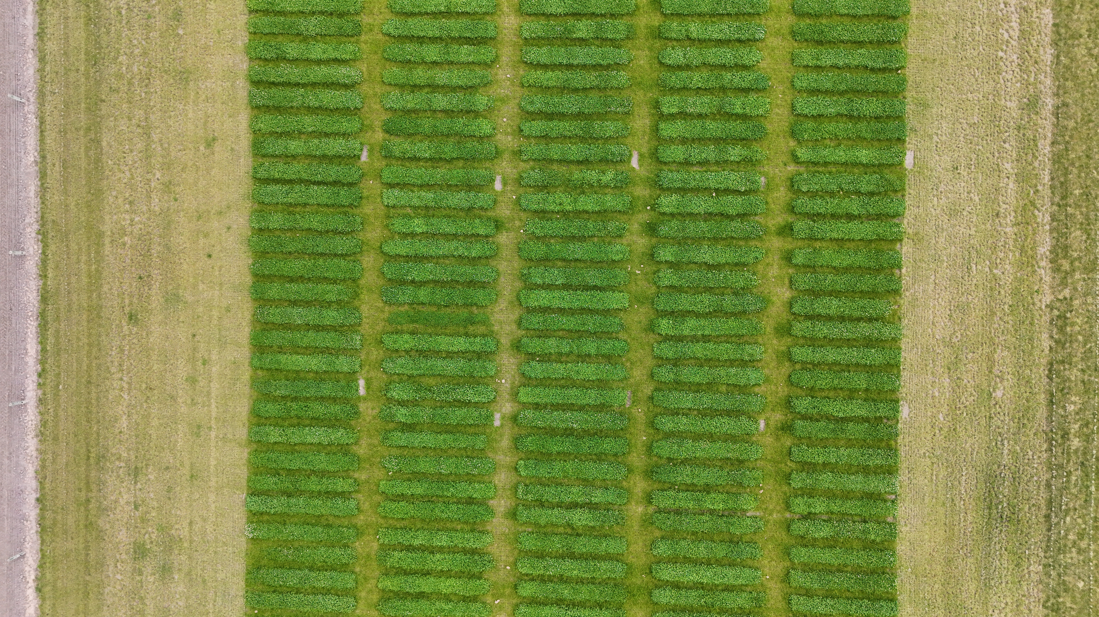


Project Goals
Improve Detection Accuracy
Ensure accurate identification of clover Plots
User-Friendly Web Application
Provide an interactive and intuitive platform for users to easily visualize and interpret results.
Structured Data for Growth Assessment
Create a database for storing, analysing and managing results and provide linked coverage data for easy assessment of clover growth
Make it a fully functional web app in real-world work

Slide 5
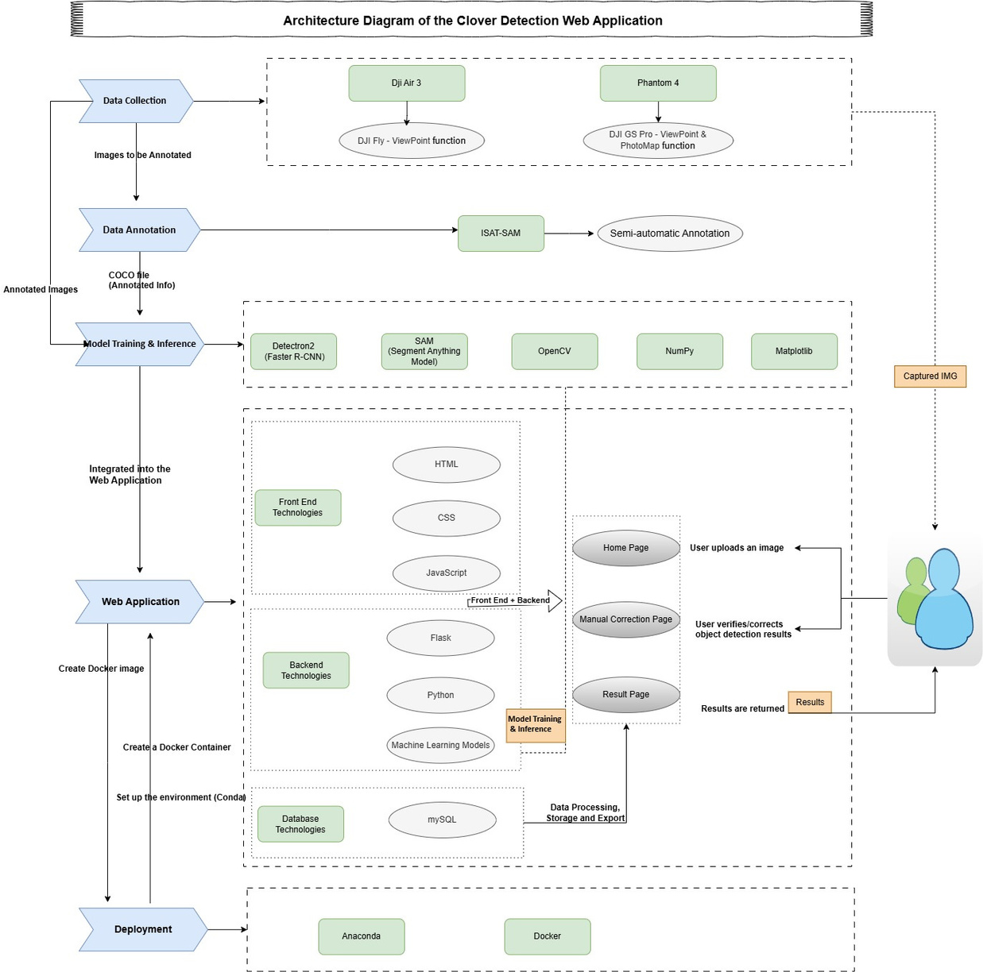
Methodology
Canvas
Boot- strap
Five key layers integrates specific tools and technologies, working together as indicated by the arrows
Birds

Slide 6
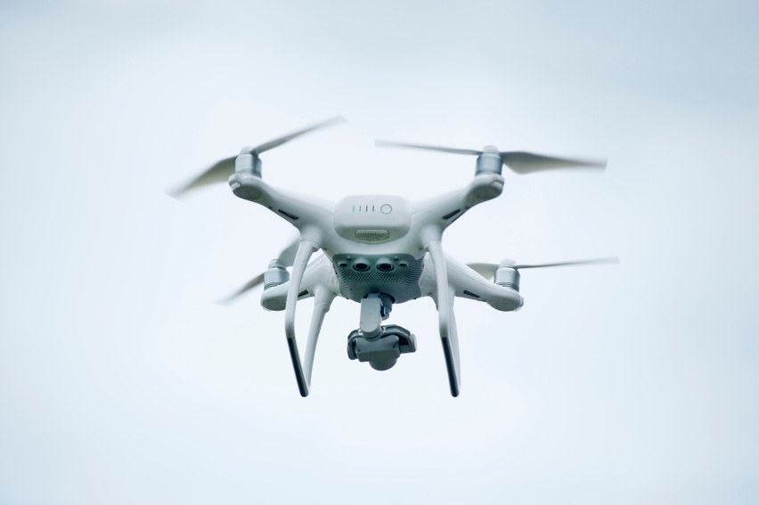
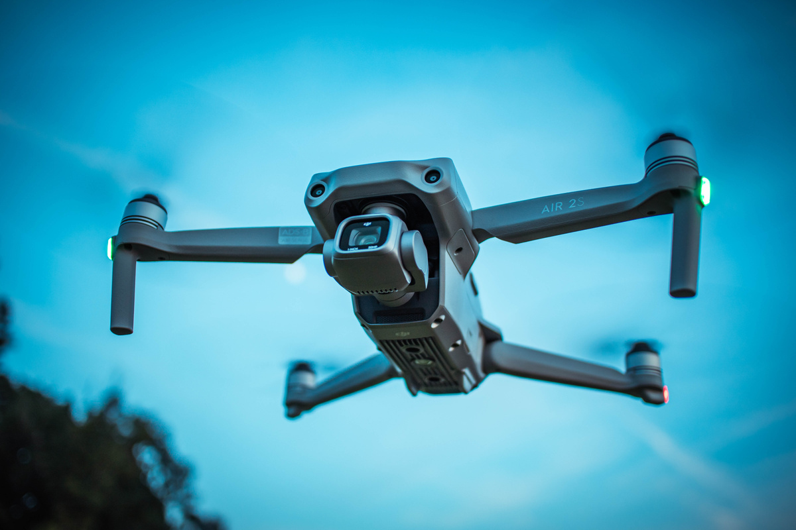
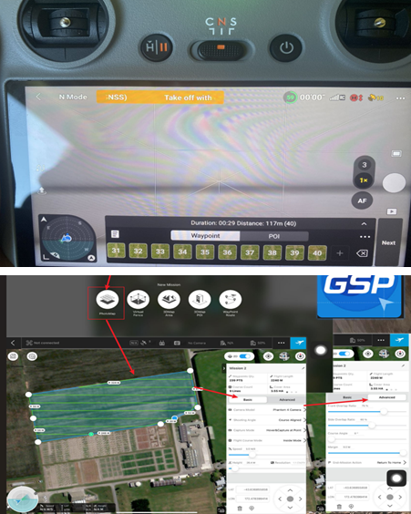
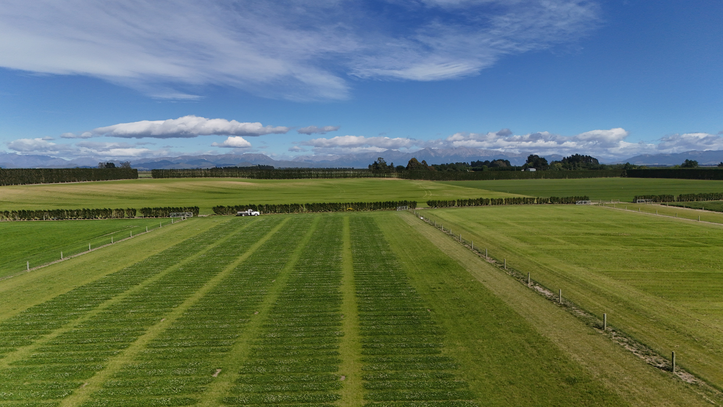
Data Collection
Capture high-resolution images of clover fields using drones
PhotoMap
ViewPoint
Birds

Slide 7
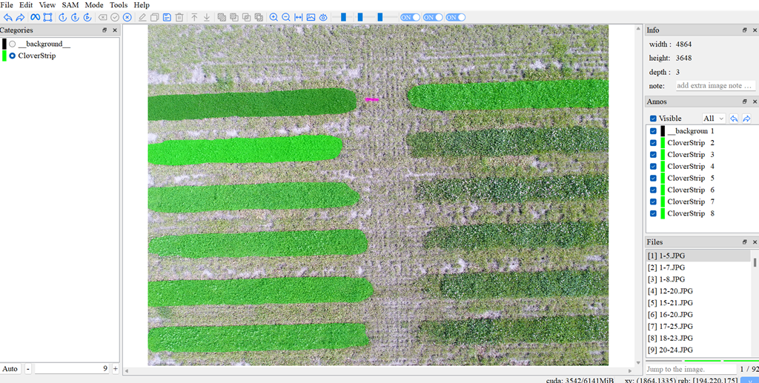
Data Annotation
Label and annotate the clover in the images before training the model
Birds

Slide 8
Integrated Web App
Feed the processed data
Generate model weights
Canvas
Boot- strap
Fully functional web application
Birds

Slide 9

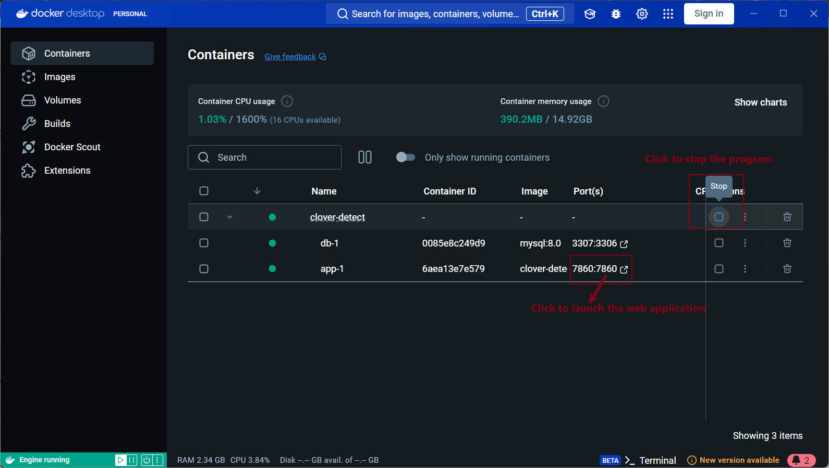
Deployment
Manages dependencies and ensures a consistent runtime environment
Creates a containerized environment for deployment
Birds

Slide 10
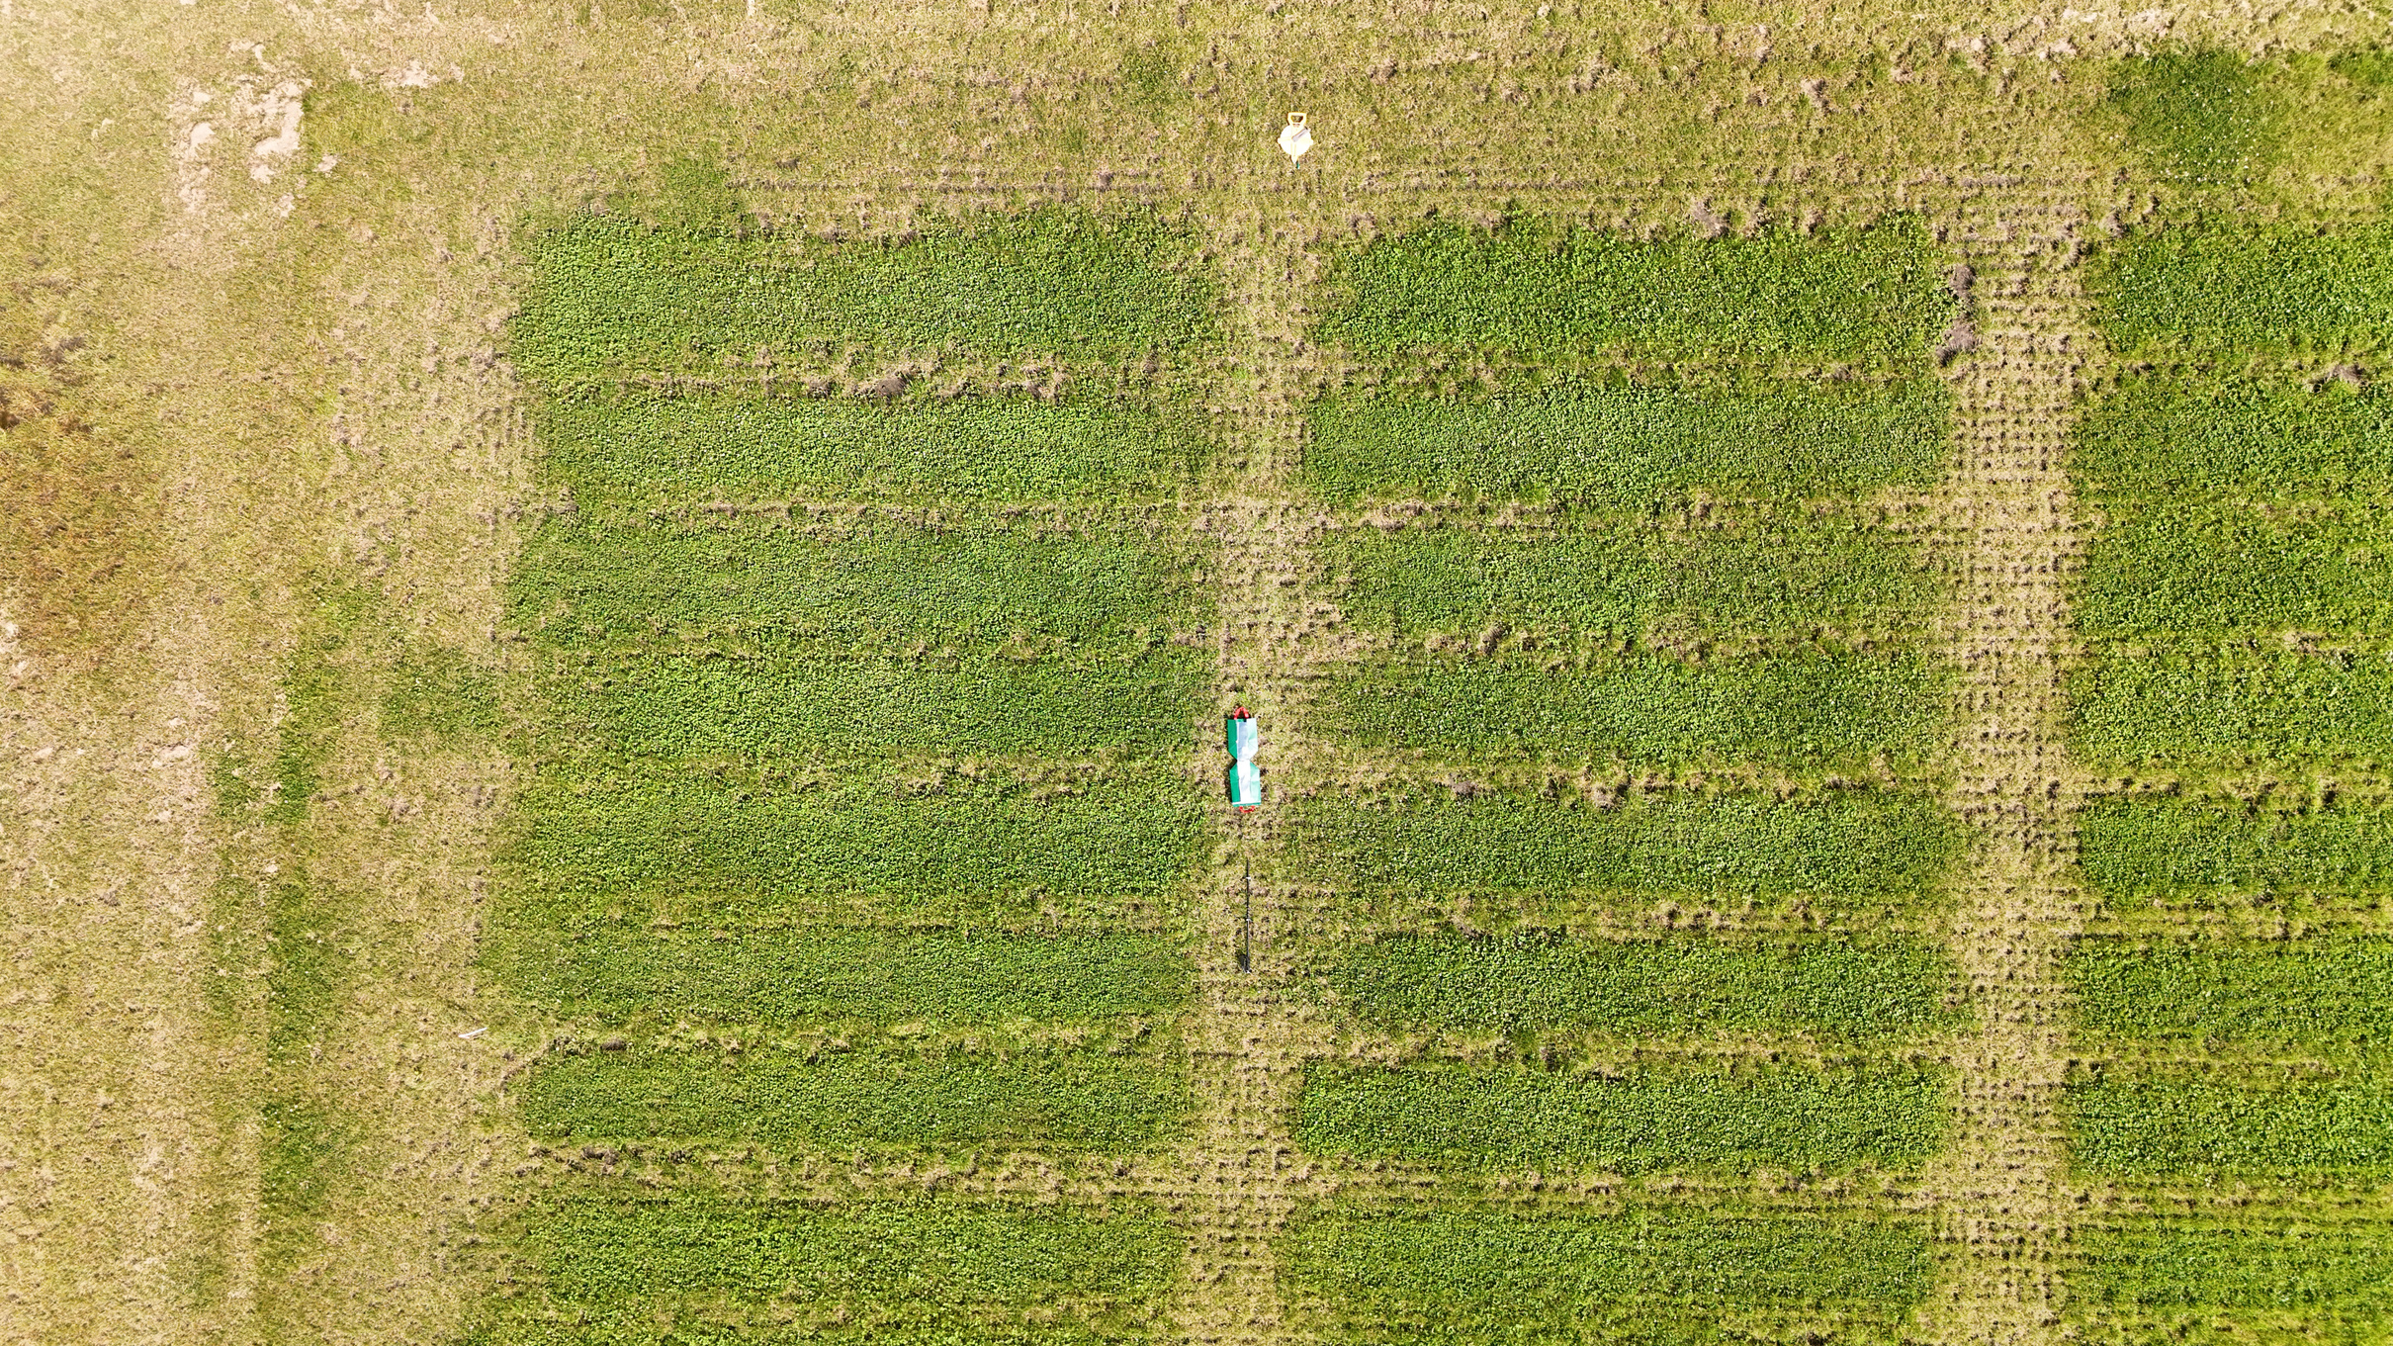
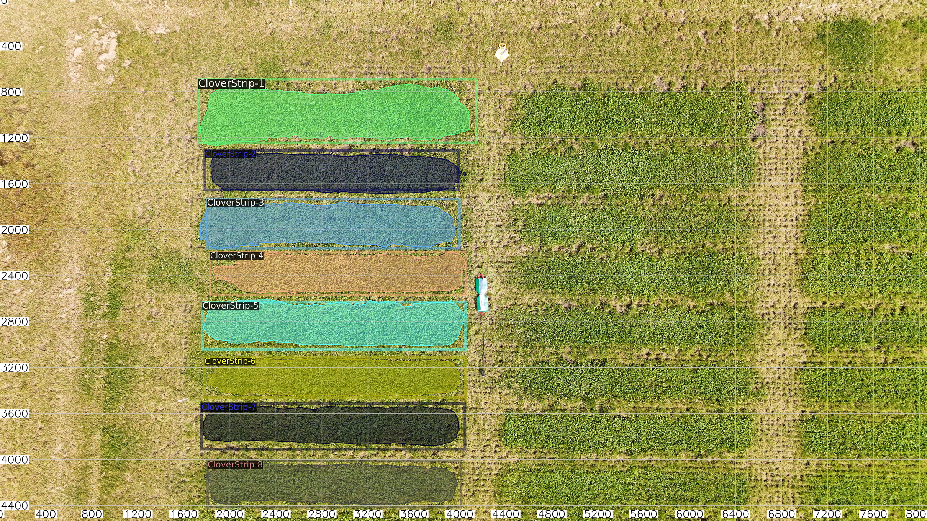
Cross Validation
Manual Scoring Data (Upper Left Corner 28/01/2025) (ID-8) | Manual Scoring Data (Upper Left Corner 28/01/2025) (ID-8) | Manual Scoring Data (Upper Left Corner 28/01/2025) (ID-8) | Manual Scoring Data (Upper Left Corner 28/01/2025) (ID-8) | Manual Scoring Data (Upper Left Corner 28/01/2025) (ID-8) | Manual Scoring Data (Upper Left Corner 28/01/2025) (ID-8)
Row | Column 1 (Plot1 – Plot8) | column 1 | column 1 | column 1 | column 1
Row | Score | Coverage |  | Green Density | Length (m)
 |  | Rank | Value(m²)
Plot 1 | 8(6.0m) | No.1 | 6.49 | 6.97 | 6.09
Plot 2 | 6(5.7m) | No.6 | 4.49 | 8.05 | 5.68
Plot 3 | 8 | No.3 | 5.06 | 12.34 | 5.79
Plot 4 | 8 | No.7 | 4.32 | 16.03 | 5.71
Plot 5 | 9 | No.2 | 5.24 | 14.16 | 5.92
Plot 6 | 7(5.8m) | No.8 | 4.20 | 9.88 | 5.71
Plot 7 | 4(5.7m) | No.5 | 4.50 | 6.19 | 5.78
Plot 8 | 7 | No.4 | 4.61 | 4.87 | 5.66
Plot 1
Plot 2
Plot 3
Plot 4
Plot 5
Highest Score
Plot 6
Plot 7
Lowest Score
Plot 8

Slide 11
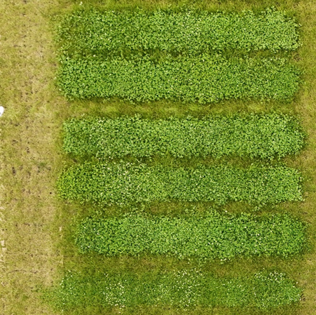
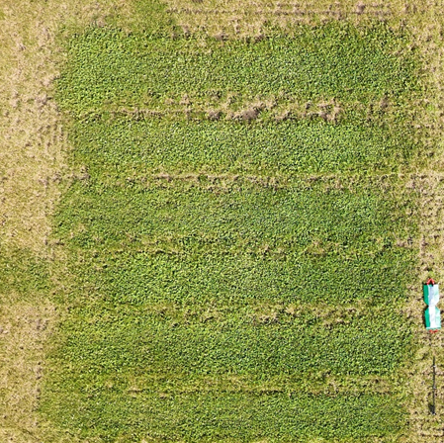
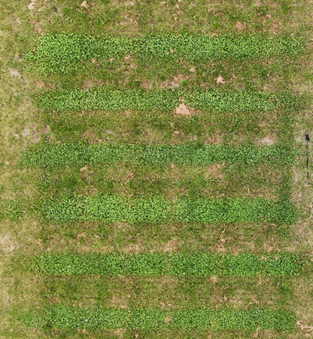
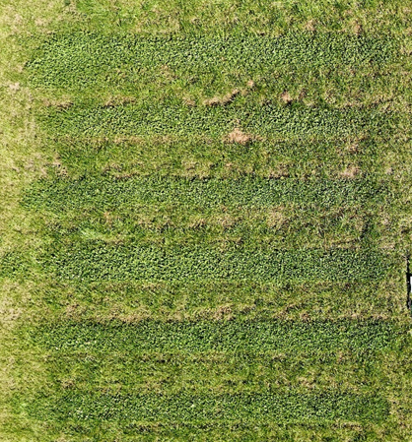
Plot 1
Plot 1
Plot 1
Plot 2
Plot 2
Plot 2
Plot 3
Plot 3
Plot 3
Plot 4
Plot 4
Plot 4
Plot 5
Plot 5
Plot 5
Plot 6
Plot 6
Plot 6
13/01/2025
Mowed
28/01/2025
Sprayed Herbicide
07/02/2025
12/02/2025
14-01-2025
31-01-2025
13/01/2025 ID-1
Plot | Green Density | Coverage |  | Length (m)
 |  | Rank | Value (m²)
1 | 29.88 | No.1 | 4.94 | 5.47
2 | 34.98 | No.2 | 4.94 | 5.49
3 | 38.57 | No.3 | 4.78 | 5.48
4 | 37.37 | No.5 | 4.47 | 5.53
5 | 53.2 | No.4 | 4.52 | 5.22
6 | 24.09 | No.6 | 3.93 | 5.57
28/01/2025 ID-8
Plot | Green Density | Coverage |  | Length (m)
 |  | Rank | Value (m²)
1 | 6.97 | No.1 | 6.49 | 6.09
2 | 8.05 | No.4 | 4.49 | 5.68
3 | 12.34 | No.3 | 5.06 | 5.79
4 | 16.03 | No.5 | 4.32 | 5.71
5 | 14.16 | No.2 | 5.24 | 5.92
6 | 9.88 | No.6 | 4.2 | 5.71
07/02/2025 ID-3
Plot | Green Density | Coverage |  | Length (m)
 |  | Rank | Value (m²)
1 | 48.83 | No.1 | 3.21 | 6.13
2 | 37.91 | No.6 | 2.29 | 5.696
3 | 62.49 | No.4 | 2.53 | 6.12
4 | 64.33 | No.2 | 2.85 | 5.57
5 | 62.36 | No.3 | 2.8 | 5.95
6 | 54.12 | No.5 | 2.49 | 5.88
12/02/2025 ID-11
Plot | Green Density | Coverage |  | Length (m)
 |  | Rank | Value (m²)
1 | 20.69 | No.1 | 3.34 | 6.23
2 | 15.45 | No.6 | 2.68 | 5.701
3 | 24.32 | No.4 | 2.71 | 6.13
4 | 25.43 | No.2 | 3.14 | 5.82
5 | 29.46 | No.3 | 3.02 | 6.16
6 | 29.29 | No.5 | 2.68 | 6.12

Slide 12


Enhanced Detection Accuracy
Manual correction capability ensures precise strip identification.
Limited to 2D Analysis: The model only evaluates surface coverage from aerial images and cannot measure plant height or density.
Advantages
Systematic Data Management
A database has been established, ranking coverage percentages and linking them to each strip’s position.
Green Pixel Density Limitations: Affected by lighting and image parameters, making cross-image comparisons difficult.
User-Centric Interface
A more intuitive and user-friendly interface enhances overall usability.
No Automated Long-Term Tracking: The system requires manual compilation for multiple growth analysis over time. Database upgrades are needed for time-series tracking and comparison.
Marker-Based Calibration
Converts image data into real-world coordinates, ensuring consistent coverage measurements across images taken at different heights.
Limitations
Green Pixel Density Metric
An indicator for evaluating growth density beyond 2D coverage analysis, partially addressing the model’s limitation of excluding height and density.
No Fixed-Length Comparison Tool: Lack a tool for users to compare fixed-length sections of each plot. While full-strip analysis is possible, a standardized selection feature is needed for more accurate comparisons.

Slide 13

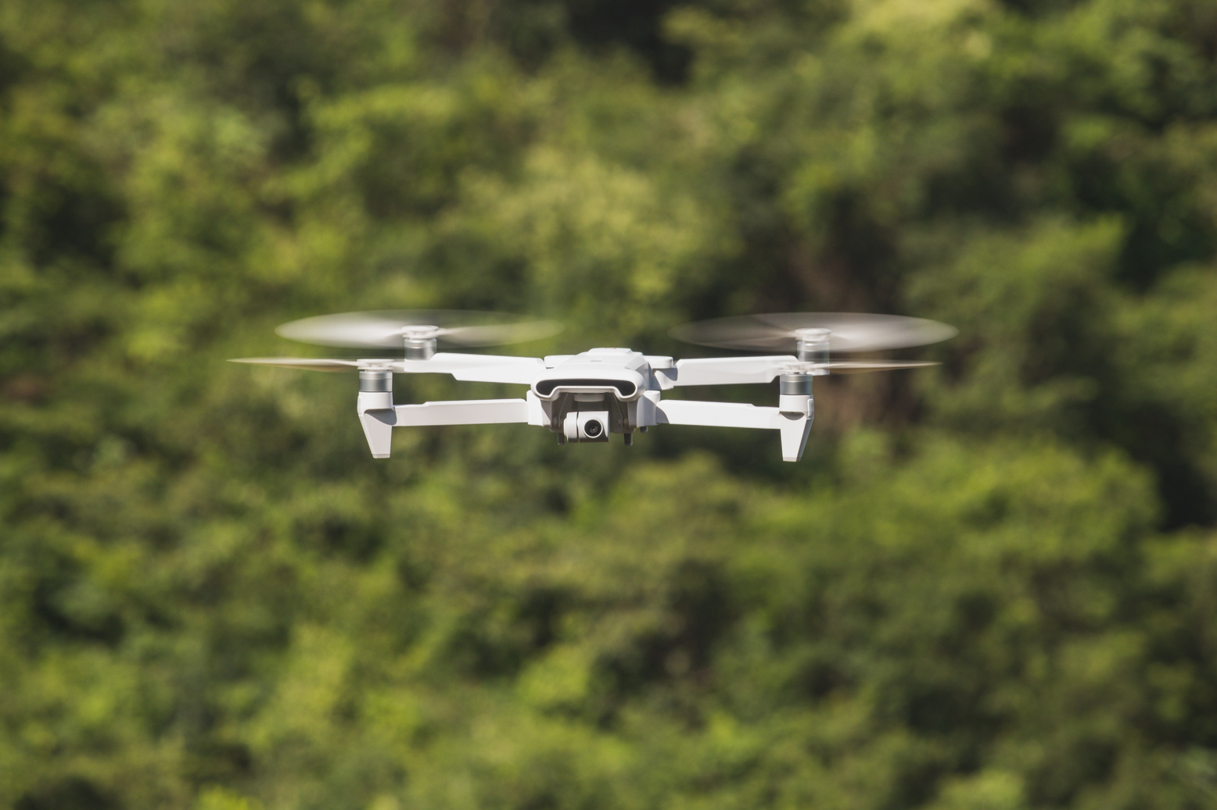
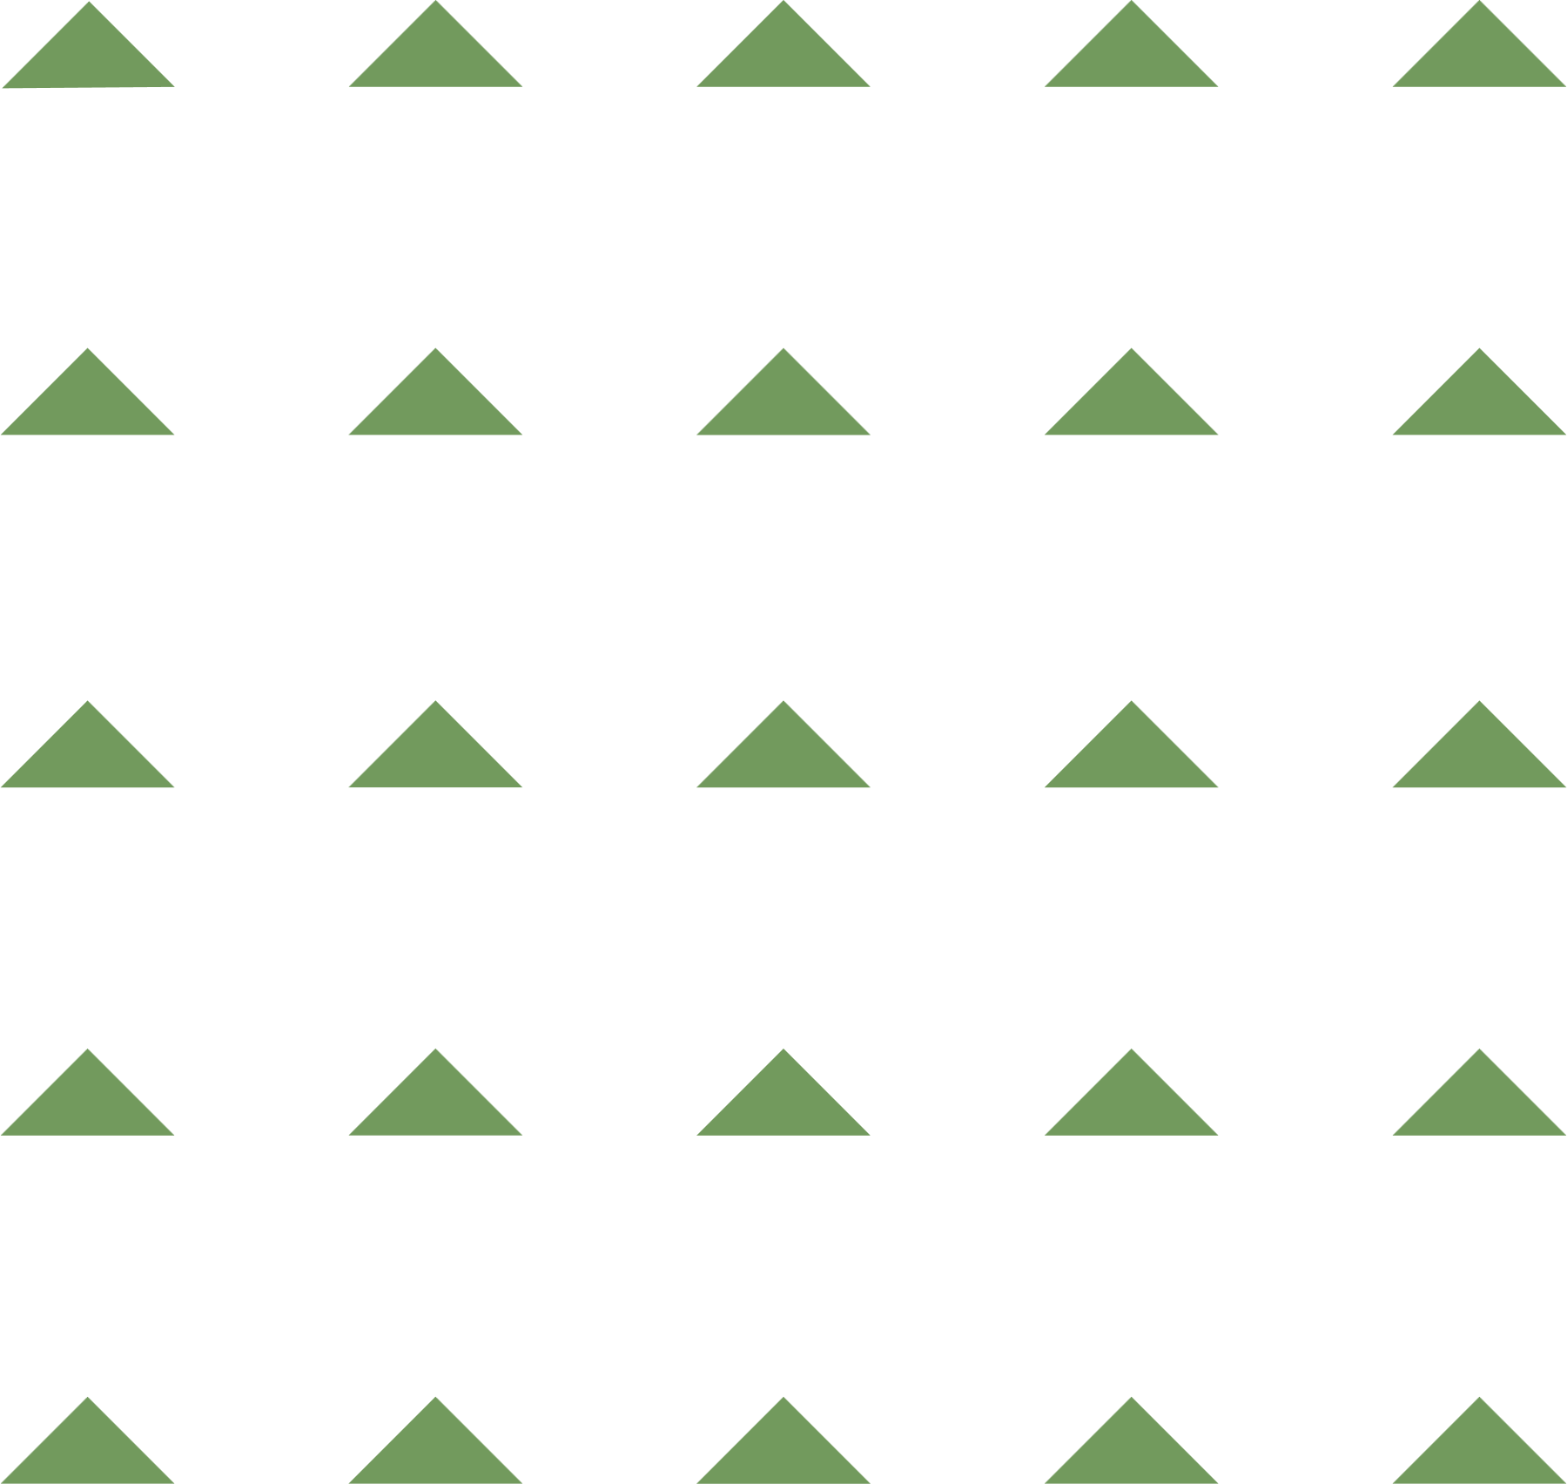


Conclusion
The system has greatly improved detection accuracy, user experience, and data tracking, making it a practical tool for monitoring clover growth. Its flexible framework allows adaptation to other crops by replacing the detection model.
However, as it relies on 2D image, the model’s coverage analysis alone does not reflect density or biomass, requiring additional factors for a more comprehensive growth assessment.

Slide 14
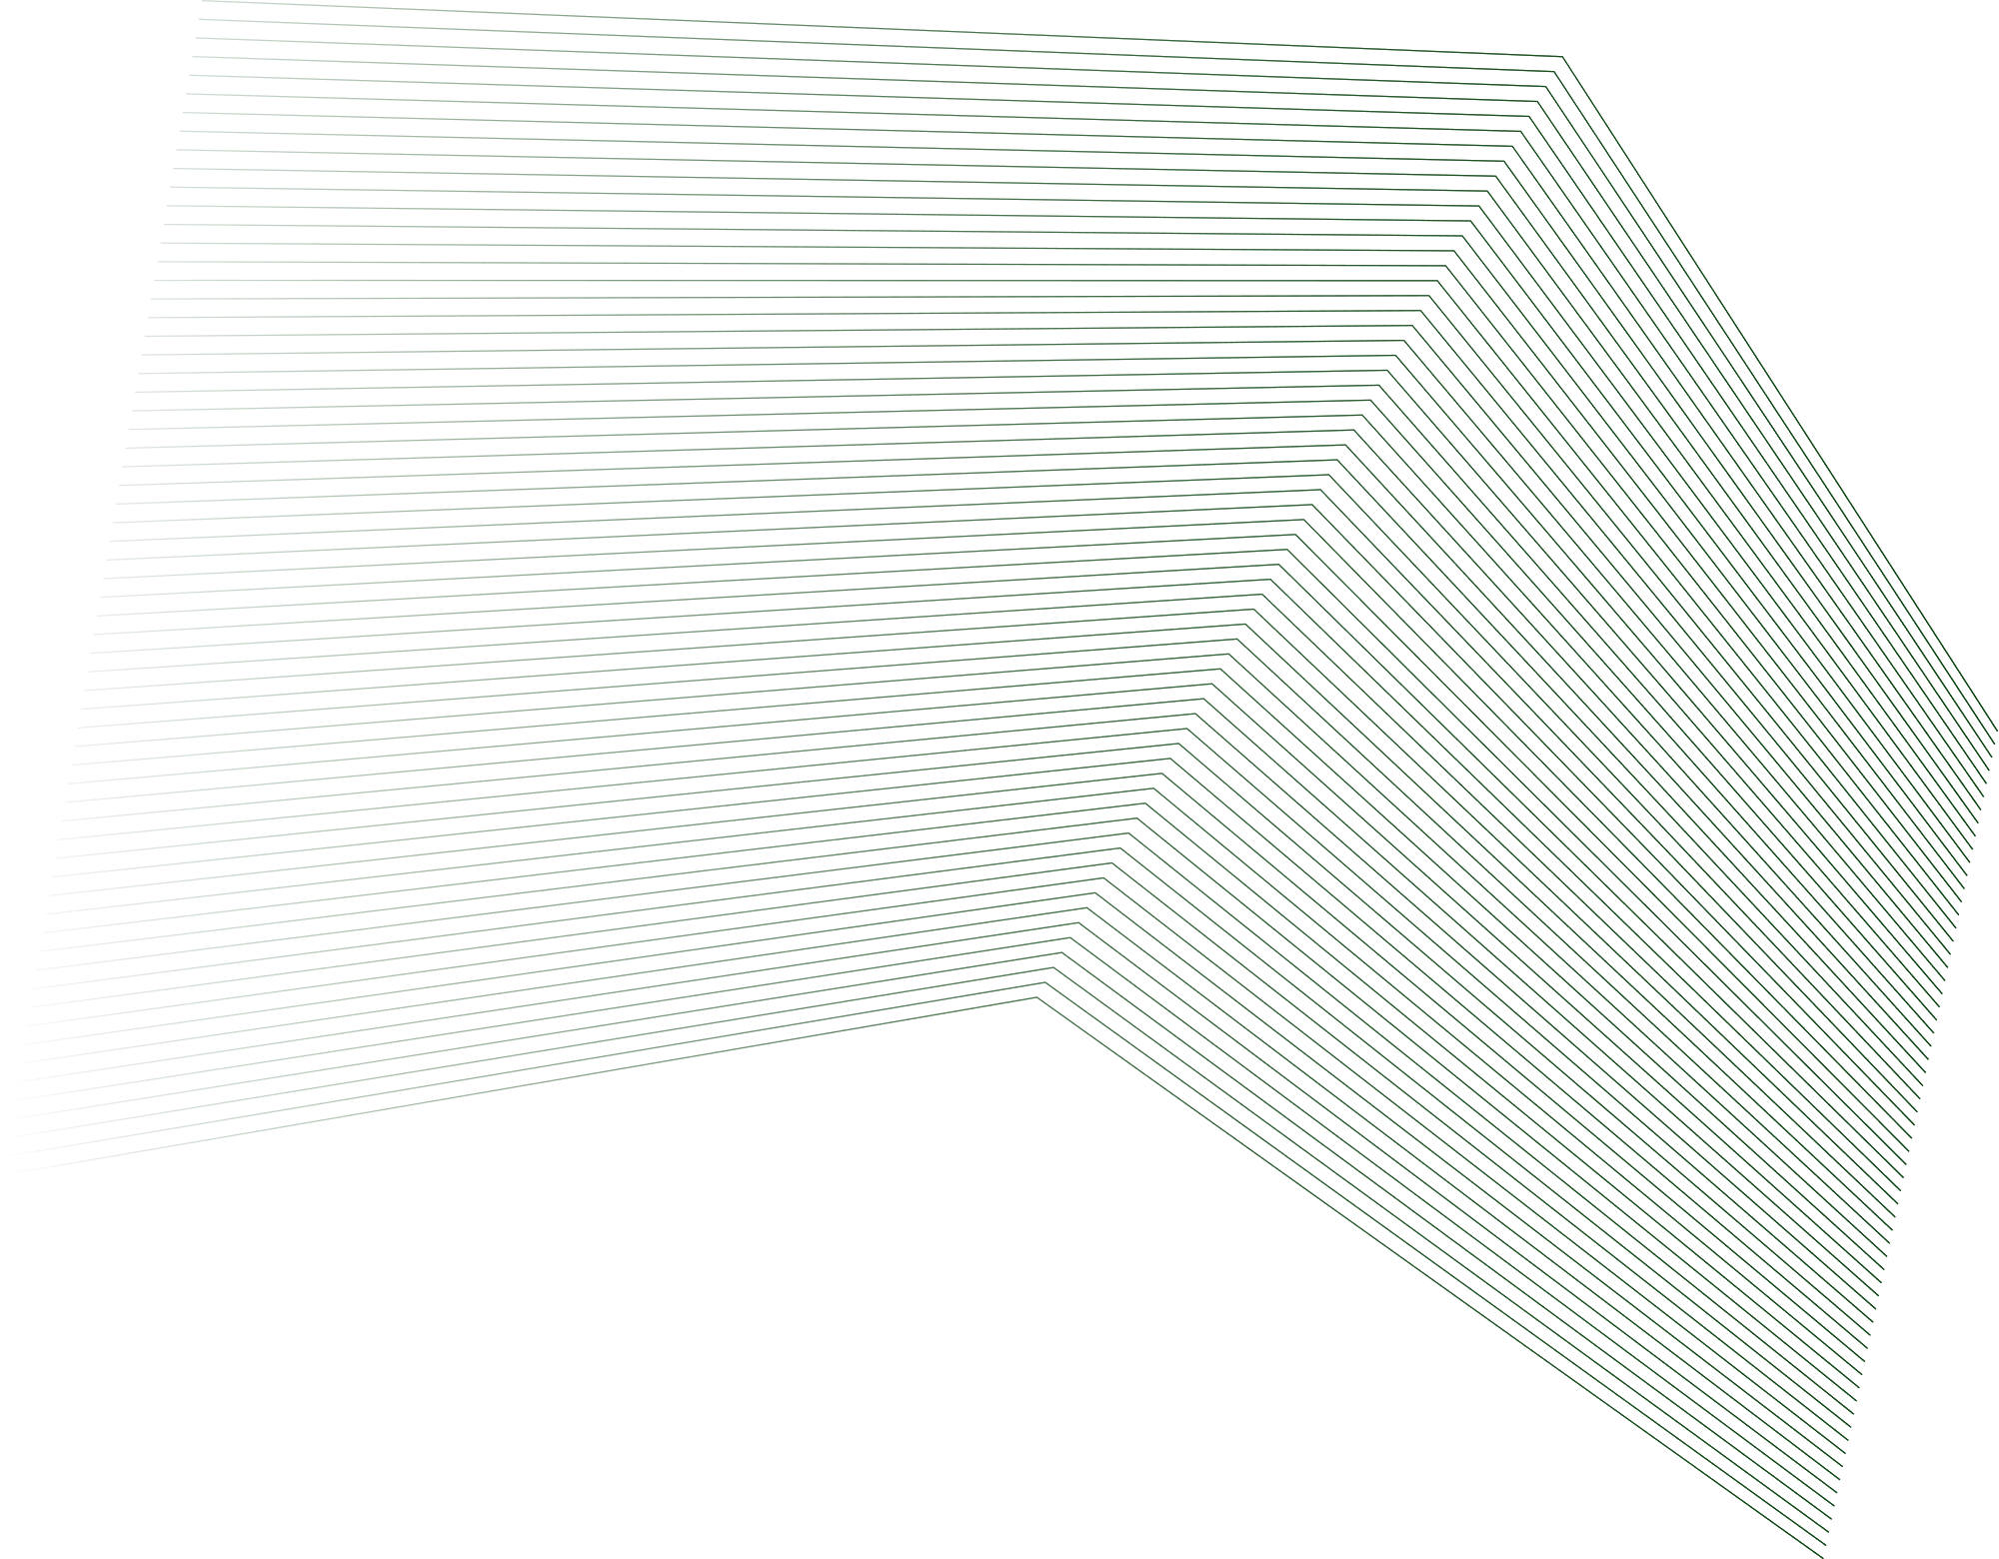
Thank you.

